Slide 1
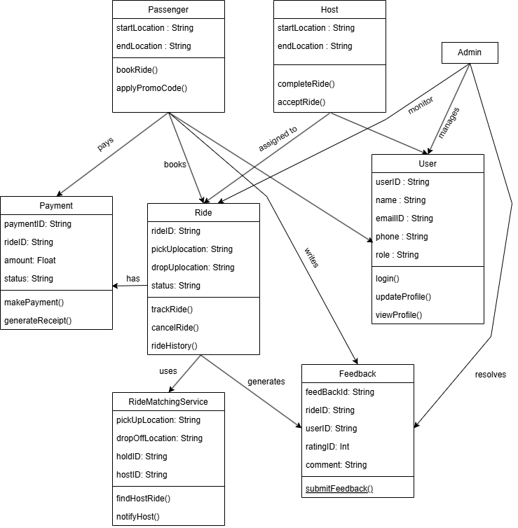
Sprint 1 & 2 : Class Diagram

Slide 2
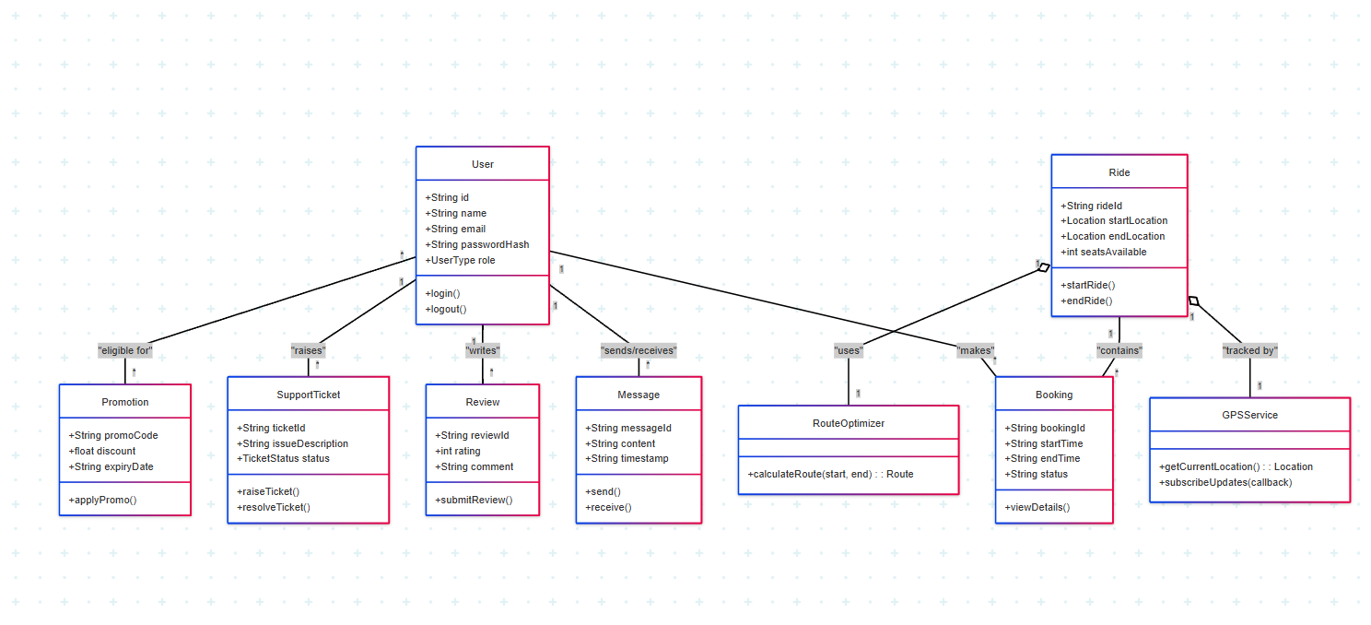
Sprint 3 : Class Diagram

